Slide 1




















Slide 2

















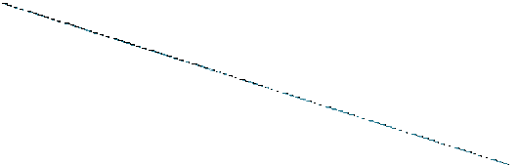


FUNCTIONALIST THEORY
CONFLICT THEORY
MULTIDIMENSIONAL THEORY

Slide 3








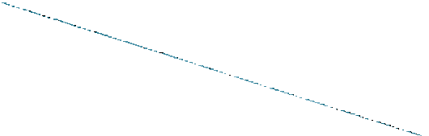
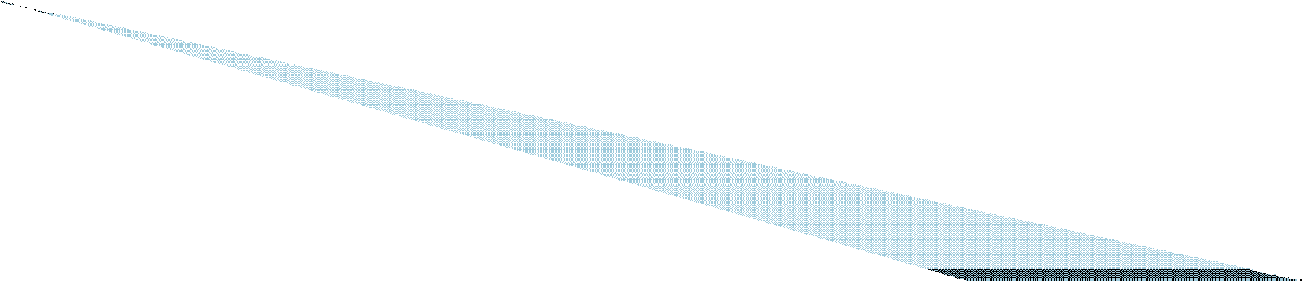
Functionalists
regards stratification as a
necessary structure in all societies because it fulfils fundamental needs vital to the functioning of the e ntire society.
Davis and moore gave the functional theory on social stratification.

Slide 4
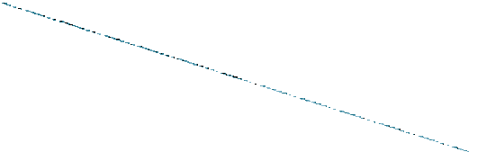

Conflict theorist argues that inequality exists in society because there is always a shortage of available valued goods and services and therefore there is always struggle over who shallget what.
Karl Marx theory of class struggle helps in understanding this view.

Slide 5
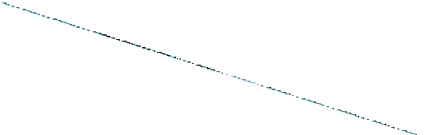

Multidimensional theory sees stratification from more than one dimension.
This approach is associated with the name of

Slide 6



















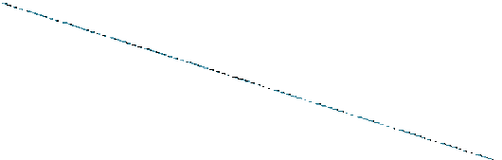

Davis-Moore seeks to explain social inequality in functional terms, the universal necessity which calls forth stratification in any social system.
According to them all social systems share certain functional pre-requisities which must be met if the system is to survive and operate efficiently.

Slide 7















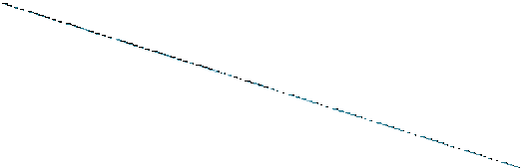

Effective role allocation and performance.
They must be filled by those best able to perform them.
The necessary training for them be undertaken.
The roles be performed conscientiously.

Slide 8













DAVIS-MOORE

Slide 9
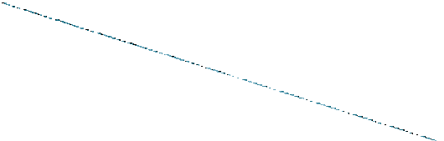

The most famous functionalist theory of stratification was first presented in 1945, in an article by the american sociologists davis and moore entitled ,some principlesof stratification.

Slide 10










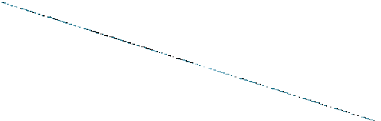

Certain positions
in any society are
functionally important than others and require special skills for their performance.
Only a limited number of persons have the
appropriate to these position.
The conversion of talent into skills involves training period during which

Slide 11
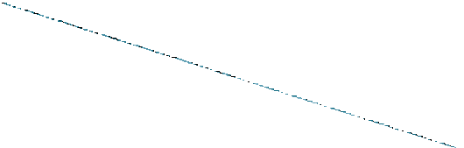

Sacrifices of one kind or another are made by those undergoing the training.
In order to encourage persons to undergo these sacrifices and acquire training, their future
form of differential i.e. Privileged and disproportionate access to the scare and desired rewards which the society has to offer.

Slide 12
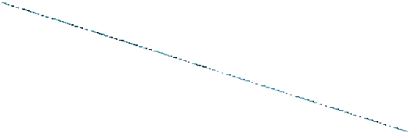

These scare and desired goods consists of rights and pre-requisites attached to or built into the positions and can be classified into those things which contribute to:
◗
B) humor and diversion
C) self- respect and ego expansion.

Slide 13
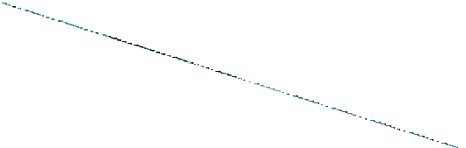

Different position are
rewards
depending
upon the and
attached
with
prestige
esteem, which divide the society into different stratas, thus those who perform important functions for the society are given higher rewards and prestige, they occupy higher positions and social inequality is thus found in society.

Slide 14


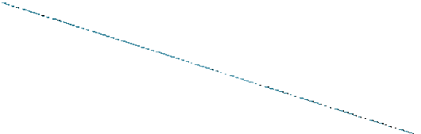


Therefore social inequality found among different strata is both positively functional and inevitable in any society.

Slide 15
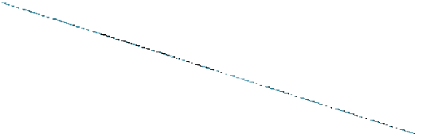

Tumin argued that there are other rewards that can be used to motivate people besides money and prestige.E.G JOY OF WORK etc.
He also argued that different societies give
Lastly he points out that social inequality is not inevitable.

Slide 16















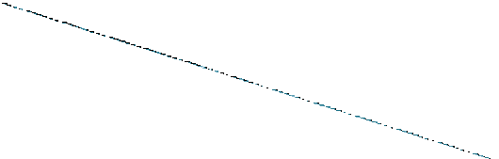

Tumin Criticized the idea of unequal functional importance of position on the ground that the concept is unclear, unmeasurable and evaluative.
◗
and talented personnel.
He argues that no differential rewards are necessary to induce individuals to qualify for functionally important position because they make no sacrifices.

Slide 17









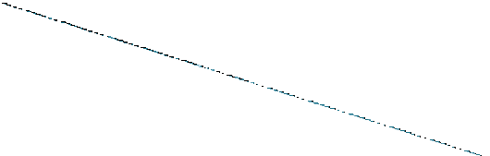

Tumin
view social stratification as divisive
rather than integrating force.
He argues that differential rewards encourages hostility, suspicion and distrust
Tumin points out that functionalists in their enthusiastic search for the positive functions of stratification have tended to ignore or play down its many dysfunctions.

Slide 18
THANK YOU

